Slide 1


1
Pizza Sales Project

Slide 2
Overview:
2
The Pizza Sales Analysis Project aims to analyze transactional sales data of a pizza store using MySQL Workbench. The project provides insights into customer preferences, best-selling pizzas, sales trends, and revenue contributions

Slide 3


3
Tool & Technology
SQL
MySQL Workbench
PROJECT DATABASE:PIZZAHUT
Tables:
Order_details
order
pizza_types
pizzas

Slide 4





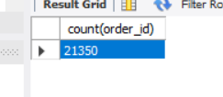
4
Retrieve the total number of orders placed

Slide 5

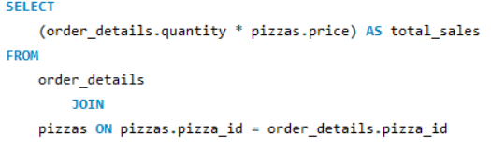
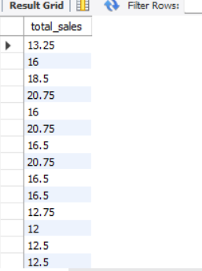
5
Calculate the total revenue generated from pizza sales

Slide 6
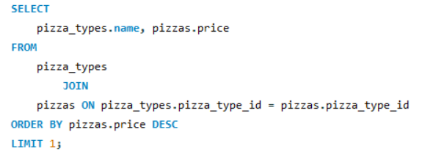
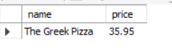
6
IDENTIFY THE HIGHEST-PRICED PIZZA

Slide 7

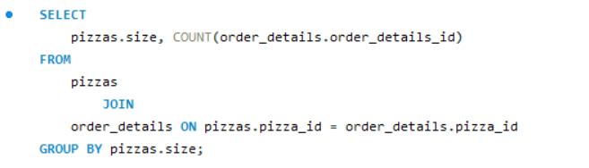
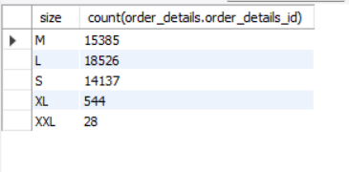
7
Identify the most common pizza size ordered

Slide 8
Conclusion:
8
The analysis of the pizza sales data using MySQL provides the following business insights:
The total number of orders helps measure customer activity and business growth.
The total revenue indicates the overall financial performance of the pizza store.
Identifying the highest-priced pizza highlights premium products that contribute to higher profit margins.
Analyzing the most common pizza size ordered provides insights into customer preferences, guiding production and inventory decisions.

